Slide 1
EXPLORATORY DATA ANALYSIS – RETAIL
GRIP – THE SPARKS FOUNDATION
PRESENTED BY:
RISHIKA HAZARIKA
DATA SCIENCE AND BUSINESS ANALYTICS INTERN

Slide 2
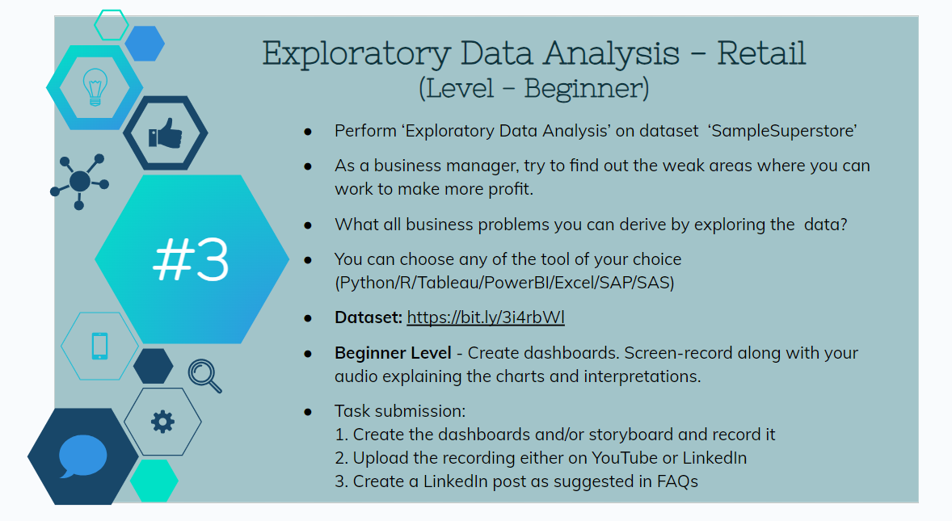
TASK 3:

Slide 3
INSIGHTS ON SALES ANALYSIS:
West region has the highest sum of sales; South has the least.
Category ‘Technology’ has the highest sum of sales, whereas ‘Office Supplies’ has the lowest sum of sales.
California (belonging to the west region) holds the highest sum of sales, whereas North Dakota (belonging to the central region) holds the least.
Shipment through standard class holds highest sum of sales; least with same day shipment.
‘Consumer’ segment experiences the highest sum of sales, with ‘Home Office’ experiencing the least.

Slide 4
INSIGHTS ON PROFIT ANALYSIS:
West region has highest sum of profit, while South has least. This shows a similar pattern to sum of sales, indicating positive correlation between sales and profit for a region.
California has the highest sum of profit. However, negative profits exist for states Oregon, Florida, Arizona, Tennessee, Colorado, North Carolina, Illinois, Pennsylvania, Ohio & Texas.
‘Furniture’ category makes the lowest profit.
Sub-categories ‘Supplies’, ‘Bookcases’ & ‘Tables’ make negative profits with ‘Tables’ making the greatest negative profit (or least profit).
Highest profit is made by shipment through standard class.
Segment ‘Consumer’ also makes greatest profit.

Slide 5
BUSINESS PROBLEMS:
Negative profits
Sales do not follow a common pattern.
Pricing
Intense competition

Slide 6
SUGGESTIONS:
To increase number of sales, following measures can be undertaken:
1. Targeted marketing strategies like local advertising, promotions, or campaigns
2. Product Optimization
3. Additional training, supervision and resources to the sales team
To increase profit and thereby curb negative profits, following measures can be suggested:
1. Cost Optimization
2. Strategic pricing without deterring customers.
3. Marketing focus on regions products perform well.
4. Mitigating high-risk areas.
5. Adjusting products based on market demand and customer feedback.

Slide 7
THANK YOU

